Slide 1
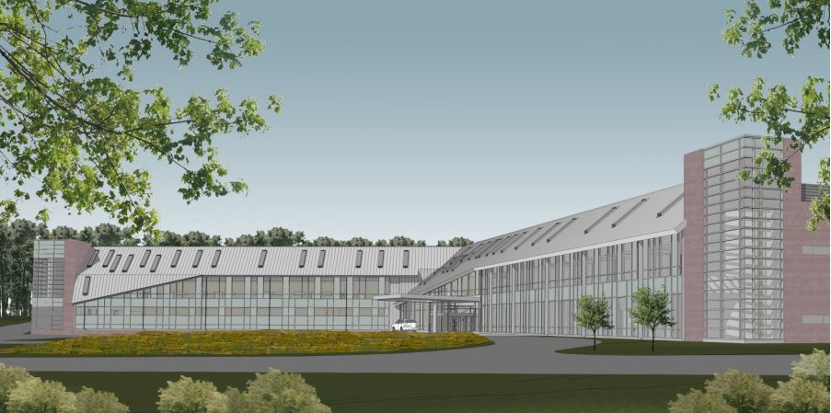
Geisinger Gray’s Woods AMbulatory Care Campus - Phase II
Penn State AE
Senior Capstone Project
George M. Andonie
Construction Option
Advisor: Rob Leicht
April 16th, 2014
**Rendering of front view supplied by Alexander Building Construction with Owner Permission

Slide 2
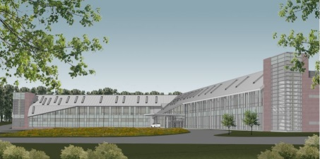
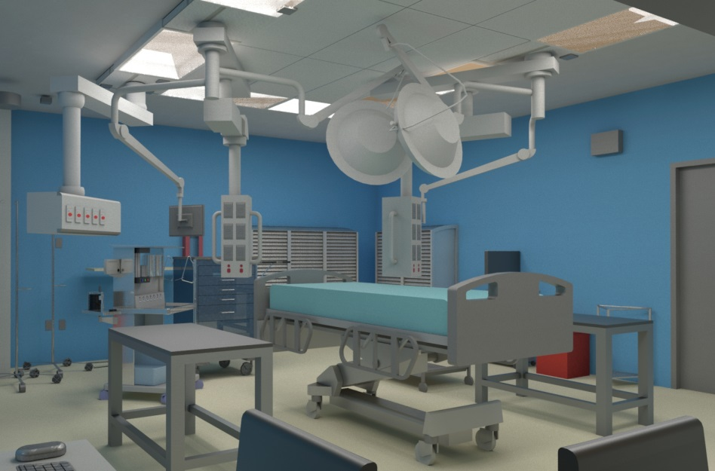
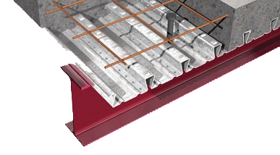
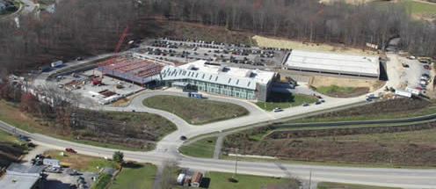
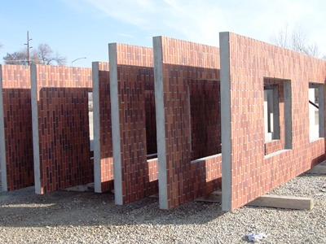
Introduction
Geisinger Grays Woods
Ambulatory Care Campus – Phase II
George M. Andonie │ Construction Option
`
Presentation Outline:
I. Introduction
II. Project Overview
III. Analysis #1: Virtual Mockups
In-Place vs. Virtual Mockups
Virtual Mockup Development
Virtual Mockup Implementation
Conclusion & Recommendation
IV. Analysis #2: Façade Prefabrication
Current vs. Prefabricated Façade
Mechanical Breadth Analysis
Schedule, Cost & Site Logistics
Conclusion & Recommendations
V. Analysis #3: Revaluating Composite Slab
Lightweight vs. Normal Concrete
Structural Breadth Analysis
Project Impacts
Conclusion & Recommendations
VI. Final Recommendations
VII. Acknowledgements
Presentation Outline:
I. Introduction
II. Project Overview
III. Analysis #1: Virtual Mockups
IV. Analysis #2: Façade Prefabrication
V. Analysis #3: Revaluating Comp. Slab
VI. Final Recommendations
VII. Acknowledgements
Analysis 1 │ Virtual Mockup Implementation
Analysis 3 │Re-valuating Composite Slab
Project Overview
Analysis 2 │ Brick Façade Prefabrication
April 16, 2014

Slide 3
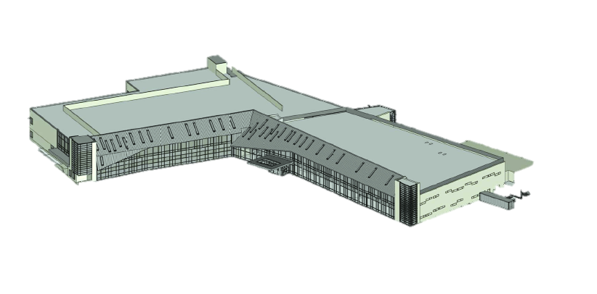
Project Background
Geisinger Grays Woods
Ambulatory Care Campus – Phase II
George M. Andonie │ Construction Option
Presentation Outline:
I. Introduction
II. Project Overview
III. Analysis #1: Virtual Mockups
In-Place vs. Virtual Mockups
Virtual Mockup Development
Virtual Mockup Implementation
Conclusion & Recommendation
IV. Analysis #2: Façade Prefabrication
Current vs. Prefabricated Façade
Mechanical Breadth Analysis
Schedule, Cost & Site Logistics
Conclusion & Recommendations
V. Analysis #3: Revaluating Composite Slab
Lightweight vs. Normal Concrete
Structural Breadth Analysis
Project Impacts
Conclusion & Recommendations
VI. Final Recommendations
VII. Acknowledgements
Presentation Outline:
I. Introduction
II. Project Overview
Project Background
III. Analysis #1: Virtual Mockups
IV. Analysis #2: Façade Prefabrication
V. Analysis #3: Revaluating Comp. Slab
VI. Final Recommendations
VII. Acknowledgements
Building Functions:
Outpatient Surgery Center
Houses 70 Exam Rooms, 4 Operating Rooms, 4 Endoscopy Suites & 2 Main Therapy Rooms
Phase 1: 2007-2008
Phase 2 :2012-2014
Project Team:
Other Owner Contracts:
General Building Information
Building Name | Grays Woods Ambulatory Care Campus
Location | Port Matilda, PA
Function | Outpatient Surgery Center
Size | 77,560 GSF
Height | 2 Stories (48' Total Height)
Cost | $26.3 Million GMP
Construction | July '12 - February '14
Delivery | Design-Bid-Build
LEED | LEED Certified
Commissioning Agent: Flood & Sterling, Inc.
HVAC Controls: Johnson Controls, Inc.
Geotechnical: CMT Laboratories, Inc.
Security: Hillman Technologies
Legend:
Guaranteed Maximum Price (GMP)
Cost + Fee Contract
Lump Sum
Communication
Other Contracts
Cost + Fee
Owner: Geisinger Health Systems
GMP
CM @ Risk: Alexander Building Construction
Phase II
Phase I
Architect: EwingCole
Lump Sum
Subcontractors:
Sitework, HVAC, Plumbing, Electrical, Concrete, Masonry, Steel, Roofing, Flooring, Windows, Doors, Drywall Fire Protection…
Structural: EwingCole
MEP: EwingCole
Civil:
Sweetland Engineering
April 16, 2014

Slide 4
Geisinger Grays Woods
Ambulatory Care Campus – Phase II
George M. Andonie │ Construction Option
Presentation Outline:
I. Introduction
II. Project Overview
III. Analysis #1: Virtual Mockups
In-Place vs. Virtual Mockups
Virtual Mockup Development
Virtual Mockup Implementation
Conclusion & Recommendation
IV. Analysis #2: Façade Prefabrication
Current vs. Prefabricated Façade
Mechanical Breadth Analysis
Schedule, Cost & Site Logistics
Conclusion & Recommendations
V. Analysis #3: Revaluating Composite Slab
Lightweight vs. Normal Concrete
Structural Breadth Analysis
Project Impacts
Conclusion & Recommendations
VI. Final Recommendations
VII. Acknowledgements
Presentation Outline:
I. Introduction
II. Project Overview
III. Analysis #1: Virtual Mockups
Problem Identification
Virtual Mockup Development
Virtual Mockup Application
Implementation & Recommendation
IV. Analysis #2: Façade Prefabrication
V. Analysis #3: Revaluating Comp. Slab
VI. Final Recommendations
VII. Acknowledgements
Analysis #1
Implementing Virtual Mockups on
Operating & Endoscopy Rooms
April 16, 2014

Slide 5
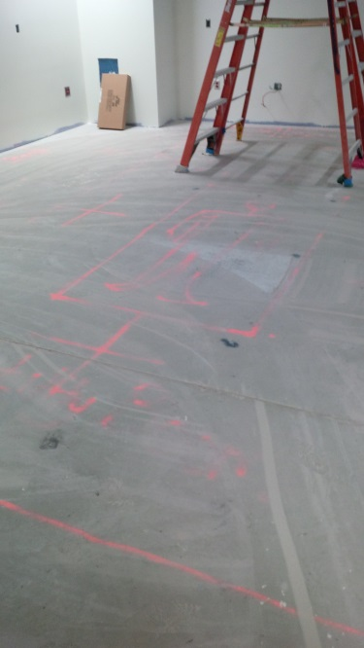
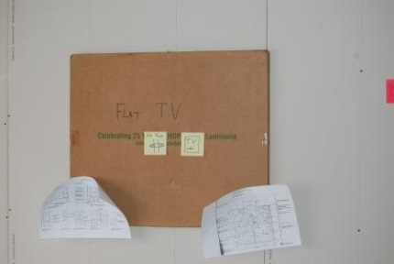
In-Place Mockup Process
Geisinger Grays Woods
Ambulatory Care Campus – Phase II
George M. Andonie │ Construction Option
Presentation Outline:
I. Introduction
II. Project Overview
III. Analysis #1: Virtual Mockups
In-Place vs. Virtual Mockups
Virtual Mockup Development
Virtual Mockup Implementation
Conclusion & Recommendation
IV. Analysis #2: Façade Prefabrication
Current vs. Prefabricated Façade
Mechanical Breadth Analysis
Schedule, Cost & Site Logistics
Conclusion & Recommendations
V. Analysis #3: Revaluating Composite Slab
Lightweight vs. Normal Concrete
Structural Breadth Analysis
Project Impacts
Conclusion & Recommendations
VI. Final Recommendations
VII. Acknowledgements
Presentation Outline:
I. Introduction
II. Project Overview
III. Analysis #1: Virtual Mockups
Problem Identification
Virtual Mockup Development
Virtual Mockup Application
Implementation & Recommendation
IV. Analysis #2: Façade Prefabrication
V. Analysis #3: Revaluating Comp. Slab
VI. Final Recommendations
VII. Acknowledgements
Problem Identification:
8-week Mock-Up Process
Low Level of Detail (LOD)
Waste Generation
Costly & Time Consuming Process
Obstruction to Schedule
Risk of Delays
Proposed Solution:
Virtual Mockups for Design Reviews
Research Goal:
Develop Virtual Mockup for Operating & Endoscopy Rooms
Capture Efforts, Criteria & Workflow
Schedule Analysis Implementation
Current Schedule:
‘In-Place Mockup’
Construction & Implementation
8 weeks
April 16, 2014

Slide 6
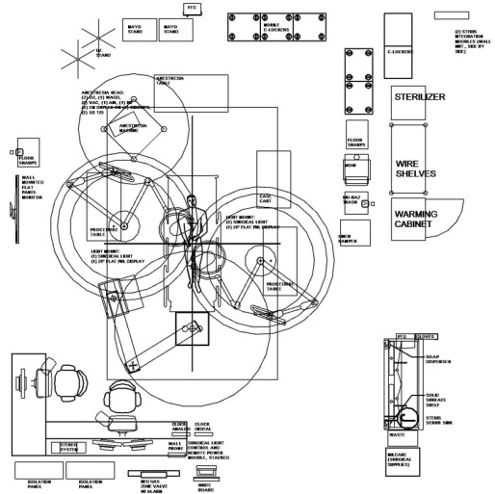
Virtual Mockup Development
Geisinger Grays Woods
Ambulatory Care Campus – Phase II
George M. Andonie │ Construction Option
Presentation Outline:
I. Introduction
II. Project Overview
III. Analysis #1: Virtual Mockups
In-Place vs. Virtual Mockups
Virtual Mockup Development
Virtual Mockup Implementation
Conclusion & Recommendation
IV. Analysis #2: Façade Prefabrication
Current vs. Prefabricated Façade
Mechanical Breadth Analysis
Schedule, Cost & Site Logistics
Conclusion & Recommendations
V. Analysis #3: Revaluating Composite Slab
Lightweight vs. Normal Concrete
Structural Breadth Analysis
Project Impacts
Conclusion & Recommendations
VI. Final Recommendations
VII. Acknowledgements
Presentation Outline:
I. Introduction
II. Project Overview
III. Analysis #1: Virtual Mockups
Problem Identification
Virtual Mockup Development
Virtual Mockup Application
Implementation & Recommendation
IV. Analysis #2: Façade Prefabrication
V. Analysis #3: Revaluating Comp. Slab
VI. Final Recommendations
VII. Acknowledgements
Development Process:
Autodesk Revit:
Model Building Space
Model MEP Systems
Model Equipment & Casework
Populate & Arrange
3ds Max:
Material Placement
Scale Adjustment
Unity Game Engine:
Scripting Model Interaction
April 16, 2014

Slide 7
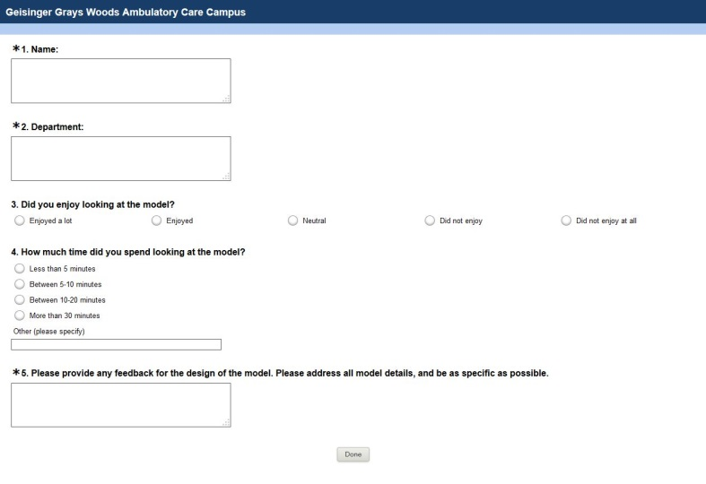
Virtual Model Application
Geisinger Grays Woods
Ambulatory Care Campus – Phase II
George M. Andonie │ Construction Option
Presentation Outline:
I. Introduction
II. Project Overview
III. Analysis #1: Virtual Mockups
In-Place vs. Virtual Mockups
Virtual Mockup Development
Virtual Mockup Implementation
Conclusion & Recommendation
IV. Analysis #2: Façade Prefabrication
Current vs. Prefabricated Façade
Mechanical Breadth Analysis
Schedule, Cost & Site Logistics
Conclusion & Recommendations
V. Analysis #3: Revaluating Composite Slab
Lightweight vs. Normal Concrete
Structural Breadth Analysis
Project Impacts
Conclusion & Recommendations
VI. Final Recommendations
VII. Acknowledgements
Presentation Outline:
I. Introduction
II. Project Overview
III. Analysis #1: Virtual Mockups
Problem Identification
Virtual Mockup Development
Virtual Mockup Application
Implementation & Recommendation
IV. Analysis #2: Façade Prefabrication
V. Analysis #3: Revaluating Comp. Slab
VI. Final Recommendations
VII. Acknowledgements
Model Application:
Model Walkthrough:
First Person Controller (FPC)
Computer/Iconn Lab
Design Review:
Functionality & Room Layout
Check Clearances
Equipment/Casework Location
Mounting heights
General Appearance
Provide Feedback:
Online Survey Completion
Welcome Menu:
Feedback Survey
Operating Room Design Review:
Endoscopy Room Design Review:
April 16, 2014

Slide 8
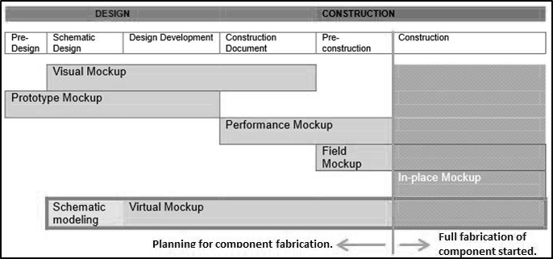
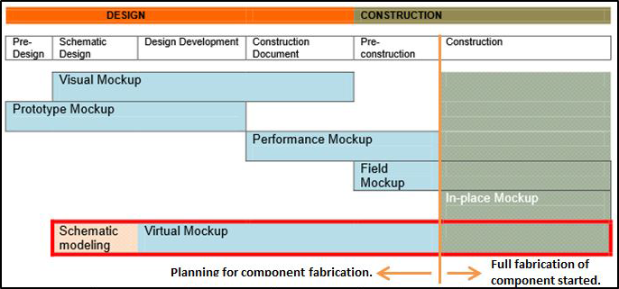
Virtual Mockup Implementation
Geisinger Grays Woods
Ambulatory Care Campus – Phase II
George M. Andonie │ Construction Option
Presentation Outline:
I. Introduction
II. Project Overview
III. Analysis #1: Virtual Mockups
In-Place vs. Virtual Mockups
Virtual Mockup Development
Virtual Mockup Implementation
Conclusion & Recommendation
IV. Analysis #2: Façade Prefabrication
Current vs. Prefabricated Façade
Mechanical Breadth Analysis
Schedule, Cost & Site Logistics
Conclusion & Recommendations
V. Analysis #3: Revaluating Composite Slab
Lightweight vs. Normal Concrete
Structural Breadth Analysis
Project Impacts
Conclusion & Recommendations
VI. Final Recommendations
VII. Acknowledgements
Presentation Outline:
I. Introduction
II. Project Overview
III. Analysis #1: Virtual Mockups
Problem Identification
Virtual Mockup Development
Virtual Mockup Application
Implementation & Recommendation
IV. Analysis #2: Façade Prefabrication
V. Analysis #3: Revaluating Comp. Slab
VI. Final Recommendations
VII. Acknowledgements
Time Requirements:
Recommendation:
Implement Virtual Mockups for Operating & Endoscopy Rooms
Potential Value Added:
Streamlining the design and construction process
Subcontractor & end user feedback
Reduce project waste (time & cost)
Strong visualization/communication tool
Ensuring the end product meets owner’s needs
No disturbance to project schedule
Schedule Implications:
Design Phase: Implement Early
Design-Review meetings between project participants & end users
Changes can be costly to implement later in the project lifecycle
Construction Phase: Visual communication of built space
Time Requirement
Step Description |  | Duration (Hrs.)
1. | Obtained Existing Revit Model | -
2. | Combine Architectural & MEP Revit Models | 2
3. | Strip Out Revit Model | 0.5
4. | Model all Owner Furnished Equipment | 8
5. | Export Model to 3Ds Max | 1
6. | Export Model to Unity | 1
7. | Develop Scripting and Textures in Unity | 8
Total |  | 20.5 Hrs
Impact of Changes
Cost of Changes
Cost Implications:
Planning
Implementation
Cost Summary
Item Description | Mhrs | Hourly Wage | Total Cost
Develop & Modify Model | 23 | $35/hr | $805
Design-Review Meetings (GC) | 50 | $65/hr | $3,250
Total | $4,055
*Costs taken from RS Means 2013
Source: Maing, M. (2012) Physical or Virtual
April 16, 2014

Slide 9
Geisinger Grays Woods
Ambulatory Care Campus – Phase II
George M. Andonie │ Construction Option
Presentation Outline:
I. Introduction
II. Project Overview
III. Analysis #1: Virtual Mockups
In-Place vs. Virtual Mockups
Virtual Mockup Development
Virtual Mockup Implementation
Conclusion & Recommendation
IV. Analysis #2: Façade Prefabrication
Current vs. Prefabricated Façade
Mechanical Breadth Analysis
Schedule, Cost & Site Logistics
Conclusion & Recommendations
V. Analysis #3: Revaluating Composite Slab
Lightweight vs. Normal Concrete
Structural Breadth Analysis
Project Impacts
Conclusion & Recommendations
VI. Final Recommendations
VII. Acknowledgements
Presentation Outline:
I. Introduction
II. Project Overview
III. Analysis #1: Virtual Mockups
IV. Analysis #2: Façade Prefabrication
Current vs. Prefabricated Façade
Panel Design
Mechanical Breadth Analysis
Panel Implementation
Conclusion & Recommendations
V. Analysis #3: Revaluating Comp. Slab
VI. Final Recommendations
VII. Acknowledgements
Analysis #2
Brick Façade Prefabrication
April 16, 2014

Slide 10
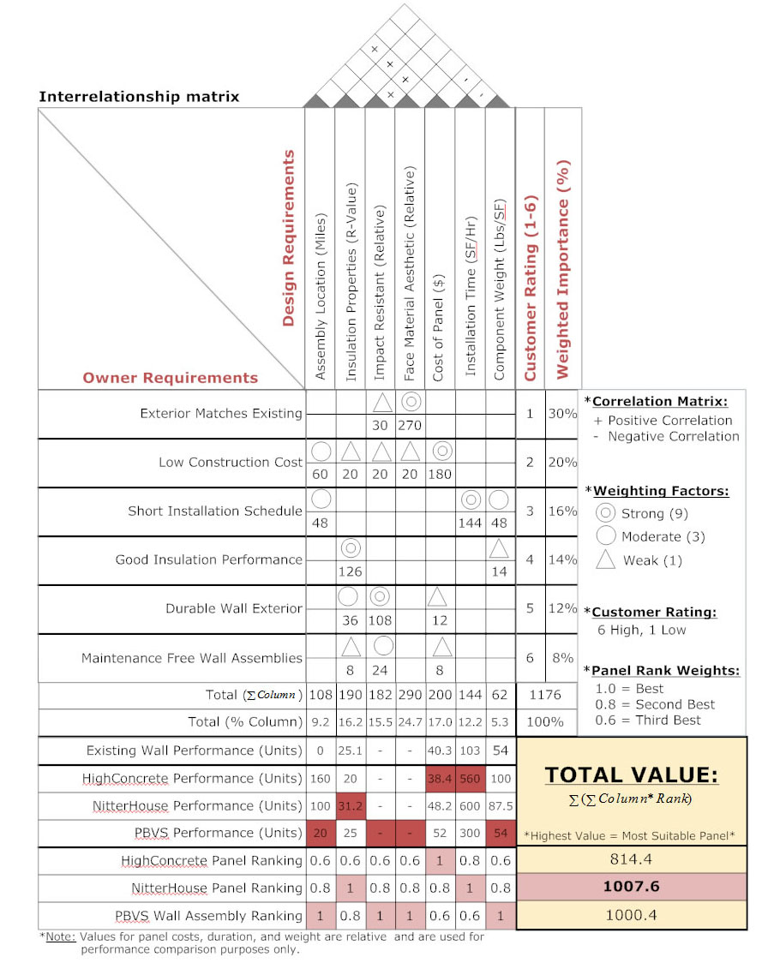
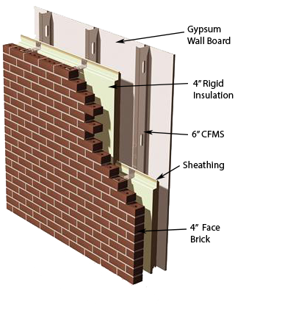
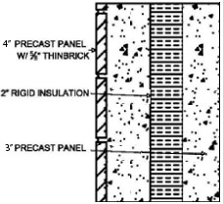
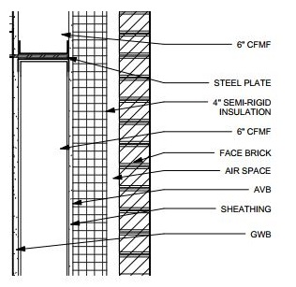
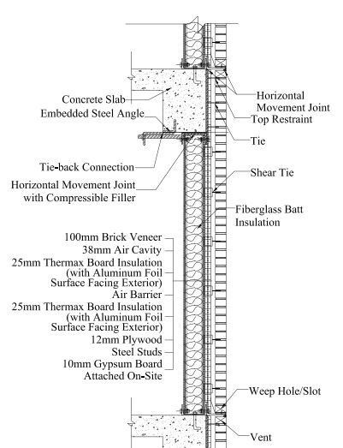
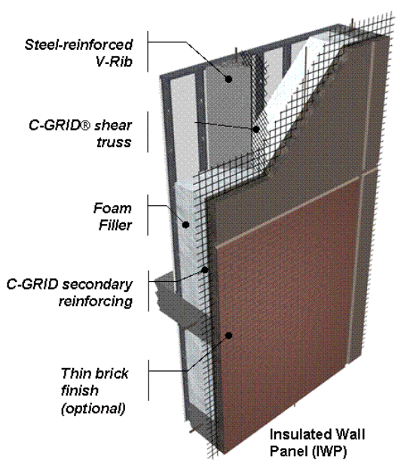
Façade Comparison
Geisinger Grays Woods
Ambulatory Care Campus – Phase II
George M. Andonie │ Construction Option
Presentation Outline:
I. Introduction
II. Project Overview
III. Analysis #1: Virtual Mockups
In-Place vs. Virtual Mockups
Virtual Mockup Development
Virtual Mockup Implementation
Conclusion & Recommendation
IV. Analysis #2: Façade Prefabrication
Current vs. Prefabricated Façade
Mechanical Breadth Analysis
Schedule, Cost & Site Logistics
Conclusion & Recommendations
V. Analysis #3: Revaluating Composite Slab
Lightweight vs. Normal Concrete
Structural Breadth Analysis
Project Impacts
Conclusion & Recommendations
VI. Final Recommendations
VII. Acknowledgements
Presentation Outline:
I. Introduction
II. Project Overview
III. Analysis #1: Virtual Mockups
IV. Analysis #2: Façade Prefabrication
Current vs. Prefabricated Façade
Panel Design
Mechanical Breadth Analysis
Panel Implementation
Conclusion & Recommendations
V. Analysis #3: Revaluating Comp. Slab
VI. Final Recommendations
VII. Acknowledgements
Proposed Facade:
9” Insulated Precast Panel
Embedded Thin Brick
Cost = $25/SF
Erection = 16 panels/ day
House of Quality:
Opportunity Identification:
Time & Labor Intensive
Site Congestion
Weather Delays
Critical Path
Original Façade:
4” Brick on Metal Stud
$674,000
178 Day Construction Duration
Customer's Needs |  | Design Requirements
Façade Aesthetics |  | Face Material Type
Low Cost |  | Assembly Location
Short Schedule |  | Erection Time
Good Thermal Performance |  | Component Weight
Durability |  | Insulation Properties
Maintenance |  | Cost of Panel
Research Goals:
Identify alternative panel
Reduce schedule & cost
Reduce site congestion & trade coordination on site
April 16, 2014
*Image Courtesy of www.veneerbricks.com
*Image Courtesy of Nitterhouse Concrete

Slide 11
Panel Design
Geisinger Grays Woods
Ambulatory Care Campus – Phase II
George M. Andonie │ Construction Option
Presentation Outline:
I. Introduction
II. Project Overview
III. Analysis #1: Virtual Mockups
In-Place vs. Virtual Mockups
Virtual Mockup Development
Virtual Mockup Implementation
Conclusion & Recommendation
IV. Analysis #2: Façade Prefabrication
Current vs. Prefabricated Façade
Mechanical Breadth Analysis
Schedule, Cost & Site Logistics
Conclusion & Recommendations
V. Analysis #3: Revaluating Composite Slab
Lightweight vs. Normal Concrete
Structural Breadth Analysis
Project Impacts
Conclusion & Recommendations
VI. Final Recommendations
VII. Acknowledgements
Presentation Outline:
I. Introduction
II. Project Overview
III. Analysis #1: Virtual Mockups
IV. Analysis #2: Façade Prefabrication
Current vs. Prefabricated Façade
Panel Design
Mechanical Breadth Analysis
Panel Implementation
Conclusion & Recommendations
V. Analysis #3: Revaluating Comp. Slab
VI. Final Recommendations
VII. Acknowledgements
Panel Design:
Consistency & transportation
Span Building Height (40’)
Maximum width 12’
Total 74 precast panels
14 different panel widths
East Elevation:
South Elevation:
North Elevation:
West Elevation:
Panel Installation Durations
Façade Orientation | Panel Qty. | Calculated Duration | Adjusted Duration
East Façade | 19 | 1.27 Days | 2 Days
South Façade | 25 | 1.67 Days | 2 Days
West Façade | 22 | 1.47 Days | 2 Days
North Façade | 8 | 0.53 Days | 1 Day
Total | 74 | 4.93 Days | 7 Days
*Durations taken from Precast Panel Takeoff, and assume productivity of 16 Panels/Day.
April 16, 2014

Slide 12
Presentation Outline:
I. Introduction
II. Project Overview
III. Analysis #1: Virtual Mockups
In-Place vs. Virtual Mockups
Virtual Mockup Development
Virtual Mockup Implementation
Conclusion & Recommendation
IV. Analysis #2: Façade Prefabrication
Current vs. Prefabricated Façade
Mechanical Breadth Analysis
Schedule, Cost & Site Logistics
Conclusion & Recommendations
V. Analysis #3: Revaluating Composite Slab
Lightweight vs. Normal Concrete
Structural Breadth Analysis
Project Impacts
Conclusion & Recommendations
VI. Final Recommendations
VII. Acknowledgements
Mechanical Breadth
Geisinger Grays Woods
Ambulatory Care Campus – Phase II
George M. Andonie │ Construction Option
Presentation Outline:
I. Introduction
II. Project Overview
III. Analysis #1: Virtual Mockups
IV. Analysis #2: Façade Prefabrication
Current vs. Prefabricated Façade
Panel Design
Mechanical Breadth Analysis
Panel Implementation
Conclusion & Recommendations
V. Analysis #3: Revaluating Comp. Slab
VI. Final Recommendations
VII. Acknowledgements
Mechanical Analysis:
Evaluate Thermal Performance
Thermal Property Comparison
Energy Performance
Breadth Conclusions:
Improved Thermal Performance (By 20%)
Heat Gain/Loss Reduction
Reduced Heating/Cooling Costs
No condensation in systems
Potentially Downsize Mechanical System
Heat Loss & Heat Gain Calculations
Wall Assembly | R - Value | U-Value | Area (SF) | Heat Loss (Winter) |  |  | Heat Gain (Summer)
 |  |  |  | ΔT (°F) |  | BTU/Hr | ΔT (°F) |  | BTU/Hr
Existing Brick Assembly | 25.05 | 0.03992 | 17,551 | 69 |  | 48,344 | 29 |  | 20,318
Precast Wall Assembly | 31.22 | 0.03203 | 17,551 | 69 |  | 38,790 | 29 |  | 16,303
Difference | 6.17 | 0.00789 | - | 9,554 BTU/hr |  |  | 4,015 BTU/hr
*R-Values taken from Nitterhouse Manufacturer
Heat Transfer Rate:
$Q=(U$-Value)*(Area)*(ΔT)
Annual Heating Fuel Consumption:
$$AHFC =\frac{24∗Q∗HDD}{{ΔT}_{w}∗HV∗HEE}$$
Annual Cooling Energy Consumption:
$$ACEC=\frac{24∗Q∗CDD}{{ΔT}_{s}∗CV}$$
April 16, 2014

Slide 13
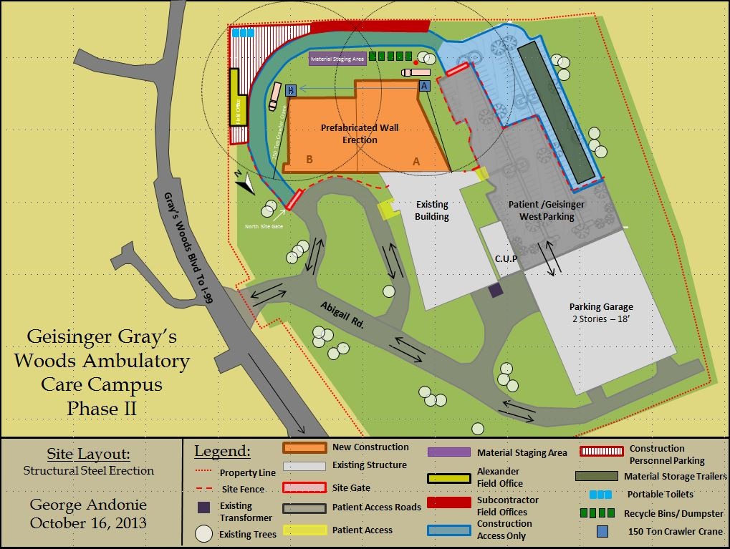
Panel Implementation
Geisinger Grays Woods
Ambulatory Care Campus – Phase II
George M. Andonie │ Construction Option
Presentation Outline:
I. Introduction
II. Project Overview
III. Analysis #1: Virtual Mockups
In-Place vs. Virtual Mockups
Virtual Mockup Development
Virtual Mockup Implementation
Conclusion & Recommendation
IV. Analysis #2: Façade Prefabrication
Current vs. Prefabricated Façade
Mechanical Breadth Analysis
Schedule, Cost & Site Logistics
Conclusion & Recommendations
V. Analysis #3: Revaluating Composite Slab
Lightweight vs. Normal Concrete
Structural Breadth Analysis
Project Impacts
Conclusion & Recommendations
VI. Final Recommendations
VII. Acknowledgements
Presentation Outline:
I. Introduction
II. Project Overview
III. Analysis #1: Virtual Mockups
IV. Analysis #2: Façade Prefabrication
Current vs. Prefabricated Façade
Panel Design
Mechanical Breadth Analysis
Panel Implementation
Conclusion & Recommendations
V. Analysis #3: Revaluating Comp. Slab
VI. Final Recommendations
VII. Acknowledgements
Site Layout:
Schedule Implications:
Subcontractor & End User Feedback
Eliminate coordination issues
No disturbance to project Schedule
Visualization of Built Space
Shorten Brick Installation by 96 Days!
Schedule Savings = 3 weeks
April 16, 2014

Slide 14
Panel Implementation
Geisinger Grays Woods
Ambulatory Care Campus – Phase II
George M. Andonie │ Construction Option
Presentation Outline:
I. Introduction
II. Project Overview
III. Analysis #1: Virtual Mockups
In-Place vs. Virtual Mockups
Virtual Mockup Development
Virtual Mockup Implementation
Conclusion & Recommendation
IV. Analysis #2: Façade Prefabrication
Current vs. Prefabricated Façade
Mechanical Breadth Analysis
Schedule, Cost & Site Logistics
Conclusion & Recommendations
V. Analysis #3: Revaluating Composite Slab
Lightweight vs. Normal Concrete
Structural Breadth Analysis
Project Impacts
Conclusion & Recommendations
VI. Final Recommendations
VII. Acknowledgements
Presentation Outline:
I. Introduction
II. Project Overview
III. Analysis #1: Virtual Mockups
IV. Analysis #2: Façade Prefabrication
Current vs. Prefabricated Façade
Panel Design
Mechanical Breadth Analysis
Panel Implementation
Conclusion & Recommendations
V. Analysis #3: Revaluating Comp. Slab
VI. Final Recommendations
VII. Acknowledgements
Final Conclusions:
74 Architectural Precast Panels
Improve Thermal Performance by 20%
Schedule Reduction = 21 Days
Implementation Cost = $50,000
Recommendation:
Not in owner’s best interest to pursue
Increased cost and planning for implementation outweigh savings in schedule and building performance
Cost Implications:
Implement = Additional $10/SF
Interior Components Same
Vapor Barrier, Sheathing & Backup
Cost Changes
2” vs. 4” Insulation
Caulking Panel Joints
General Conditions Savings
21 Days = $43,663
Building Enclosure Construction Cost Comparison
Material Description | Total | Unit | Prefabricated Panels |  | Traditional Brick
 |  |  | Cost/SF | Total Cost | Cost/SF | Total Cost
Exterior Face Wall | 17,551 | SF | $25.00 | $438,775 | $16.10 | $282,571
Interior Component | 17,551 | SF | $19.63 | $344,485 | $19.63 | $344,485
Insulation (2" or 4") | 17,551 | SF | $1.37 | $24,045 | $2.68 | $47,037
Caulking | 3,360 | LF | $2.16 | $7,258 | - | -
Transportation | - | - | Included | Included | - | -
Erection Equipment (Scaffolding or Crane) | - | - | Included | Included | - | $47,037
Total |  |  | $48.2 | $814,563 | $38.4 | $721,130
Costs provided by Nitterhouse Concrete, RS Means 2013, and Actual Project Costs
Building Enclosure Cost Comparison Summary
Item Description | Prefabricated Panels Total Cost | Existing Brick Total Cost
Cost of Assembly | $814,562.69 | $721,130
General Conditions Cost | $742,260.05 | $785,922
Total | $1,556,823 | $1,507,052
**Estimated Assembly costs based on RS Means 2013, Nitterhouse Concrete, and Actual Project Costs
April 16, 2014

Slide 15
Geisinger Grays Woods
Ambulatory Care Campus – Phase II
George M. Andonie │ Construction Option
Presentation Outline:
I. Introduction
II. Project Overview
III. Analysis #1: Virtual Mockups
In-Place vs. Virtual Mockups
Virtual Mockup Development
Virtual Mockup Implementation
Conclusion & Recommendation
IV. Analysis #2: Façade Prefabrication
Current vs. Prefabricated Façade
Mechanical Breadth Analysis
Schedule, Cost & Site Logistics
Conclusion & Recommendations
V. Analysis #3: Revaluating Composite Slab
Lightweight vs. Normal Concrete
Structural Breadth Analysis
Project Impacts
Conclusion & Recommendations
VI. Final Recommendations
VII. Acknowledgements
Presentation Outline:
I. Introduction
II. Project Overview
III. Analysis #1: Virtual Mockups
IV. Analysis #2: Façade Prefabrication
V. Analysis #3: Revaluating Comp. Slab
Problem Identification
Structural Breadth Analysis
Project Impacts & Recommendations
VI. Final Recommendations
VII. Acknowledgements
Analysis #3
Re-evaluation of Structural Composite Slab
April 16, 2014

Slide 16
Existing Conditions
Geisinger Grays Woods
Ambulatory Care Campus – Phase II
George M. Andonie │ Construction Option
Presentation Outline:
I. Introduction
II. Project Overview
III. Analysis #1: Virtual Mockups
In-Place vs. Virtual Mockups
Virtual Mockup Development
Virtual Mockup Implementation
Conclusion & Recommendation
IV. Analysis #2: Façade Prefabrication
Current vs. Prefabricated Façade
Mechanical Breadth Analysis
Schedule, Cost & Site Logistics
Conclusion & Recommendations
V. Analysis #3: Revaluating Composite Slab
Lightweight vs. Normal Concrete
Structural Breadth Analysis
Project Impacts
Conclusion & Recommendations
VI. Final Recommendations
VII. Acknowledgements
Presentation Outline:
I. Introduction
II. Project Overview
III. Analysis #1: Virtual Mockups
IV. Analysis #2: Façade Prefabrication
V. Analysis #3: Revaluating Comp. Slab
Problem Identification
Structural Breadth Analysis
Project Impacts & Recommendations
VI. Final Recommendations
VII. Acknowledgements
Opportunity Identification:
Vale Engineering on Structural System (20% of Building Costs)
Reduce Overall Building Costs
Proposed Solution:
Change Lightweight Composite Deck to Normal Concrete
NW = Lower Material Cost
Research Goal:
Reduce building costs
Improve building performance
Existing Conditions:
38,000 SF of Composite Floor
3 ¼” Lightweight Concrete
2” Composite Metal Decking (18-Gauge)
Typical 30’ x 30’ Bays (40)
LIGHTWEIGHT
NORMAL
BOTH
Unit Cost: $134/CY
Unit Weight: 115pcf
High Fire Resistance
(3¼” for 2-hr Rating)
Retain More Moisture
Unit Cost: $102/CY
Unit Weight: 150pcf
Low Fire Resistance
(4½" for 2-hr Rating)
Vibration Performance
Strength
Placing
Finish
Current Typical Bay (LW Concrete)
April 16, 2014

Slide 17
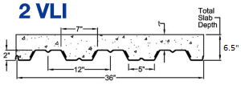
Structural Breadth
Geisinger Grays Woods
Ambulatory Care Campus – Phase II
George M. Andonie │ Construction Option
Presentation Outline:
I. Introduction
II. Project Overview
III. Analysis #1: Virtual Mockups
In-Place vs. Virtual Mockups
Virtual Mockup Development
Virtual Mockup Implementation
Conclusion & Recommendation
IV. Analysis #2: Façade Prefabrication
Current vs. Prefabricated Façade
Mechanical Breadth Analysis
Schedule, Cost & Site Logistics
Conclusion & Recommendations
V. Analysis #3: Revaluating Composite Slab
Lightweight vs. Normal Concrete
Structural Breadth Analysis
Project Impacts
Conclusion & Recommendations
VI. Final Recommendations
VII. Acknowledgements
Presentation Outline:
I. Introduction
II. Project Overview
III. Analysis #1: Virtual Mockups
IV. Analysis #2: Façade Prefabrication
V. Analysis #3: Revaluating Comp. Slab
Problem Identification
Structural Breadth Analysis
Project Impacts & Recommendations
VI. Final Recommendations
VII. Acknowledgements
Structural Calculations:
Determine NW Deck Assembly
Check Beam Sizing
Check Girder Sizing
Check Column Sizing
Check Footing Sizing
Breadth Conclusions:
4 ½” NW Composite Deck
Increase Reinforcement
Beam Spacing and Size
Girder Sizes Increase to W24x68
360lbs of Steel/Bay
Column and Footing Sizes Acceptable
Member Quantity Constant
No Additional Fireproofing
CURRENT TYPICAL BAY
(LIGHTWEIGHT CONCRETE)
PROPOSED TYPICAL BAY DESIGN
(NORMAL CONCRETE)
Existing LW Design
Item Description | Size
LW Concrete Material | 3.25"
Concrete Placing | <6"
Concrete Reinforcing | 6x6 W1.4xW1.4
Floor Decking | 2VLI18
Shear Studs | ½” Diameter
Steel Beams (4) | W18x35
Steel Girders (2) | W24x62
Steel Columns (2) | W10x49
Additional Fireproofing | -
Proposed NW Design
Item Description | Size
NW Concrete Material | 4.5"
Concrete Placing | <6"
Concrete Reinforcing | 6x6 W2.1xW2.1
Floor Decking | 2VLI18
Shear Studs | ½” Diameter
Steel Beams (4) | W18x35
Steel Girders (2) | W24x68
Steel Columns (2) | W10x49
Additional Fireproofing | -
Proposed Typical Bay (NW Concrete)
Source: Vulcraft Decking Catalog
April 16, 2014

Slide 18
Project Impacts
Geisinger Grays Woods
Ambulatory Care Campus – Phase II
George M. Andonie │ Construction Option
Presentation Outline:
I. Introduction
II. Project Overview
III. Analysis #1: Virtual Mockups
In-Place vs. Virtual Mockups
Virtual Mockup Development
Virtual Mockup Implementation
Conclusion & Recommendation
IV. Analysis #2: Façade Prefabrication
Current vs. Prefabricated Façade
Mechanical Breadth Analysis
Schedule, Cost & Site Logistics
Conclusion & Recommendations
V. Analysis #3: Revaluating Composite Slab
Lightweight vs. Normal Concrete
Structural Breadth Analysis
Project Impacts
Conclusion & Recommendations
VI. Final Recommendations
VII. Acknowledgements
Presentation Outline:
I. Introduction
II. Project Overview
III. Analysis #1: Virtual Mockups
IV. Analysis #2: Façade Prefabrication
V. Analysis #3: Revaluating Comp. Slab
Problem Identification
Structural Breadth Analysis
Project Impacts & Recommendations
VI. Final Recommendations
VII. Acknowledgements
Construction Implications:
Floor-to-floor height:
Loose 1.25” per floor
Absorbed by ceiling plenum
Beam Deflections:
Impact on building’s serviceability
Addressed in Structural Analysis
Improved Quality Control:
Moisture Content
Fireproofing
Cost Implications:
Implementing change increases system cost by 3%
Concrete costs still increased
Largest % Increase = Reinforcement
Metal Decking & Studs Constant
Final Conclusions:
Initial Goal = Reduce Project Costs
Escalate Costs by $27,344
Upsize Girders (Additional 7.2 Tons of Steel)
Revised Goal = Improve Building Performance
Vibration, Moisture, & Fireproofing
Recommend Change:
Improved Quality Control
Reduce Risks of Escalating Project Cost & Schedule
Could have saved over $100,000 in project
Overall Cost Comparison
Item Description | System A: Proposed NW | System B: Existing LW | Cost Ratio (A/B)
Concrete Material & Placing | $85,068.00 | $80,643.60 | 1.05
Concrete Reinforcing | $15,480.00 | $12,960.00 | 1.19
Composite Metal Decking | $136,440.00 | $136,440.00 | 1.00
Headed Shear Stud Connectors | $22,080.00 | $22,080.00 | 1.00
Structural Steel Framing | $713,904.00 | $693,504.00 | 1.03
Additional Fireproofing | - | - | -
TOTAL | $972,972 | $945,627 | 1.03
Costs taken from 30x30' Typical Bay Detailed Estimate (Assuming 40 Bays)
April 16, 2014

Slide 19
Conclusions
Geisinger Grays Woods
Ambulatory Care Campus – Phase II
George M. Andonie │ Construction Option
Presentation Outline:
I. Introduction
II. Project Overview
III. Analysis #1: Virtual Mockups
In-Place vs. Virtual Mockups
Virtual Mockup Development
Virtual Mockup Implementation
Conclusion & Recommendation
IV. Analysis #2: Façade Prefabrication
Current vs. Prefabricated Façade
Mechanical Breadth Analysis
Schedule, Cost & Site Logistics
Conclusion & Recommendations
V. Analysis #3: Revaluating Composite Slab
Lightweight vs. Normal Concrete
Structural Breadth Analysis
Project Impacts
Conclusion & Recommendations
VI. Final Recommendations
VII. Acknowledgements
Presentation Outline:
I. Introduction
II. Project Overview
III. Analysis #1: Virtual Mockups
IV. Analysis #2: Façade Prefabrication
V. Analysis #3: Revaluating Comp. Slab
VI. Final Recommendations
VII. Acknowledgements
Analysis 1 │ Virtual Mockup Implementation:
Implement Virtual Mockups for the facility’s Operating & Endoscopy Rooms
Save Cost
Save Time
Reduce Risk
Solve Constructability Issues
Analysis 2 │ Brick Façade Prefabrication
Would not recommend the prefabrication of the building’s facade
Increased Cost & Planning
Reduced Schedule & Building Performance
Improve Efficiency
Increased Collaboration
Streamline Process
Reduce Risk
Reduce Cost
Reduce Schedule
Improve Quality Control
Analysis 3 │ Re - evaluating Composite Slab
Recommend Changing from LW to NW Composite Slab
Improved Quality Control (Reduce Risk)
Increased Cost
April 16, 2014

Slide 20
Acknowledgements
Geisinger Grays Woods
Ambulatory Care Campus – Phase II
George M. Andonie │ Construction Option
Presentation Outline:
I. Introduction
II. Project Overview
III. Analysis #1: Virtual Mockups
In-Place vs. Virtual Mockups
Virtual Mockup Development
Virtual Mockup Implementation
Conclusion & Recommendation
IV. Analysis #2: Façade Prefabrication
Current vs. Prefabricated Façade
Mechanical Breadth Analysis
Schedule, Cost & Site Logistics
Conclusion & Recommendations
V. Analysis #3: Revaluating Composite Slab
Lightweight vs. Normal Concrete
Structural Breadth Analysis
Project Impacts
Conclusion & Recommendations
VI. Final Recommendations
VII. Acknowledgements
Presentation Outline:
I. Introduction
II. Project Overview
III. Analysis #1: Virtual Mockups
IV. Analysis #2: Façade Prefabrication
V. Analysis #3: Revaluating Comp. Slab
VI. Final Recommendations
VII. Acknowledgements
Special Thanks to:
My Family & Friends
Geisinger Health Systems
Douglas Workman, Josh Progar & Alexander’s Project Team
Mathew Hoerner - Alexander Building Construction
Ray Sowers & Ed Gannon - Penn State’s OPP
Mark Taylor – Nitterhouse Concrete
Sonali Kumar – Balfour Resource Group
George Burnley – High Concrete Group
PACE Industry Members
Industry Acknowledgements:
Architectural Engineering Faculty:
Dr. Rob Leicht (Advisor)
Dr. John Messner
Dr. Ali Memari
April 16, 2014

Slide 21
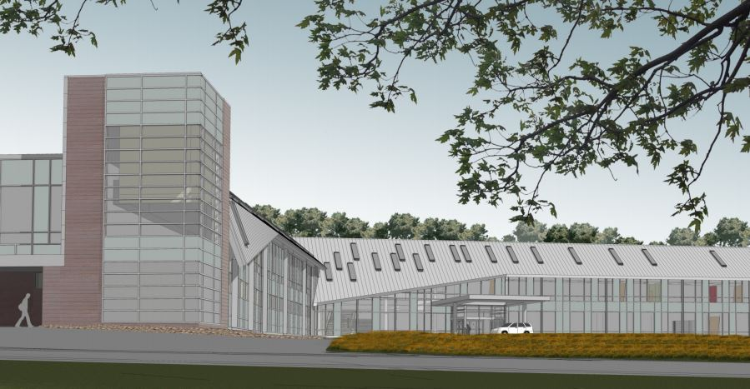
Thank You
Geisinger Grays Woods
Ambulatory Care Campus – Phase II
George M. Andonie │ Construction Option
Presentation Outline:
I. Introduction
II. Project Overview
III. Analysis #1: Virtual Mockups
In-Place vs. Virtual Mockups
Virtual Mockup Development
Virtual Mockup Implementation
Conclusion & Recommendation
IV. Analysis #2: Façade Prefabrication
Current vs. Prefabricated Façade
Mechanical Breadth Analysis
Schedule, Cost & Site Logistics
Conclusion & Recommendations
V. Analysis #3: Revaluating Composite Slab
Lightweight vs. Normal Concrete
Structural Breadth Analysis
Project Impacts
Conclusion & Recommendations
VI. Final Recommendations
VII. Acknowledgements
Questions & Comments
**Rendering courtesy of Alexander Building Construction with Owner Permission
**Rendering courtesy of Alexander Building Construction with Owner Permission
April 16, 2014

